Slide 1
Advanced Academics at Coral Glades High School
Principal: Dr. Mark J. Kaplan
Assistant Principal: Wendy Bernstein
Advanced Academics Coordinator: Lisa Plass

Slide 2
Benefits of Cambridge
International High School Diploma
College Credit (must sit for and pass the international exam.)
Weighted GPA
Rigorous course work
Automatic Bright Futures Scholarship Qualifier (Students still need the 100 service hours)

Slide 3
Cambridge 2022-2023
Group 1
Marine Science
Environmental Management (1 or 3)
Psychology (1 or 3)
Physical Education
Criteria
Within a three-year period, candidates must earn a minimum of seven credits (sit for and pass the international exams) one from each of subject groups 1 - 3 plus Global Perspectives and optionally, Group 4 to be awarded the AICE diploma.
Group 2
English Language
Spanish Language
Group 4*
English General Paper
Thinking Skills AS & A level
Global Perspectives A level
*Two credits ONLY from Group 4
Group 3
European History
American History
Psychology (1 or 3)
Media Studies AS & A level
Environmental Management (1 or 3)
Compulsory
Global Perspectives AS level

Slide 4
English General Paper - 9th grade students who have scored a level 3 or higher on the state exam. Thinking Skills – Students who are enrolled in geometry or higher and have appropriate math FSA scores. AICE Geography- Students who have scored a level 3 or higher on the state exam.
Coral Glades Expectations

Slide 5
Benefits of Advanced Placement
College Credit (must sit for and pass the national exam.)
Weighted GPA
Rigorous course work

Slide 6
AP Human Geography- 9th grade students who have scored a level 3 or higher on the state exam. AP Computer Science Principles- Must have completed geometry. Many options for students in grades 10-12
Advanced Placement in 9th Grade

Slide 8
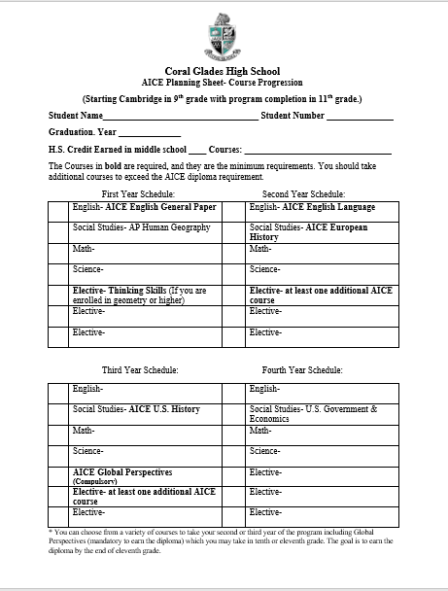
Course Planning
Sheet

Slide 9
Get involved at
Coral Glades!
Make a friend.
Make a change.
Make a difference.

Slide 10
Coral Glades High School Graduates!
Massachusetts Institute of Technology
Harvard University
Emory University
Dartmouth College
Columbia University
Vanderbilt
Stanford University
Washington University in St. Louis
West Point Academy
Boston University
Brown University
University of Pennsylvania
Northwestern University
George Washington University
Cornell University
New York University
USC
Duke

Slide 11
Additional information can be found on the Coral Glades website! https://www.browardschools.com/coralglades Email me at lisa.plass@browardschools.com

